Slide 1


Financial Highlights
As of August 31, 2023
One Minute Report – Click Below
https://www.showme.com/sh?h=txzsvuC

Slide 2

Highlights of Interim Financial Report (unaudited)
August 31, 2023

Slide 3


Posted on Our Website
Finance / Monthly Finance Reports (hcde-texas.org)
Linked from State Comptroller’s website
http://www.texastransparency.org/local/schools.php

Slide 4

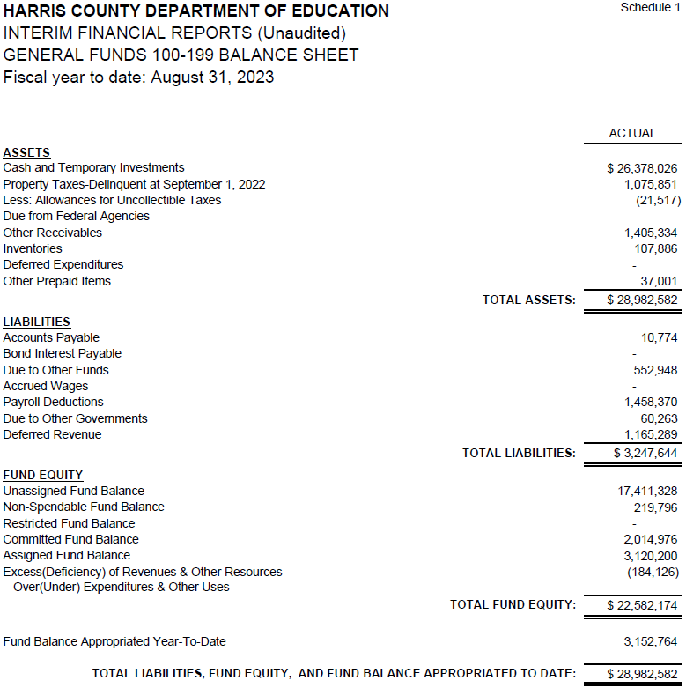
INTERIM FINANCIAL REPORT
(unaudited)
GENERAL FUND
Balance Sheet as of August 31, 2023
Total Assets:
$ 28,982,582
Total Liabilities:
$ 3,247,644
Total Fund Equity:
$ 28,982,582

Slide 5
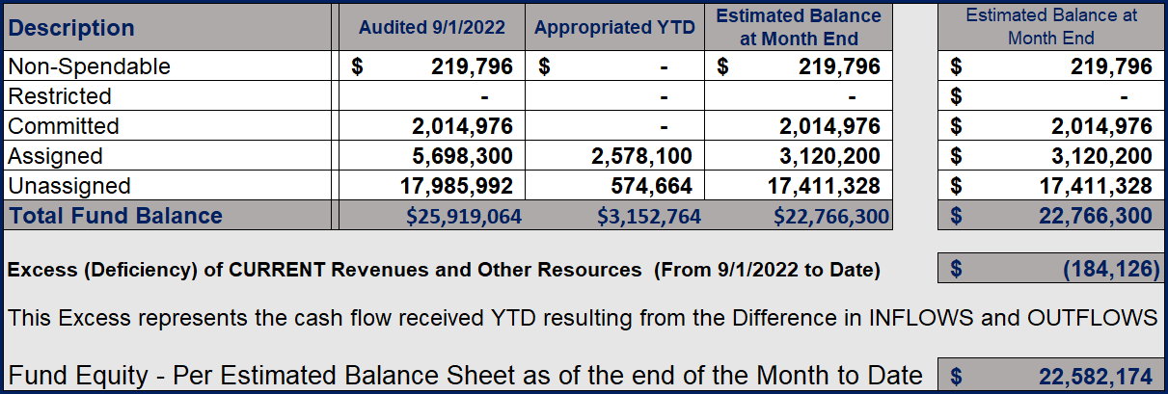
INTERIM FINANCIAL REPORT (unaudited)
ASST. SUPERINTENDENT FOR BUSINESS SERVICES MESSAGE
As of August 31, 2023
The ESTIMATED General Fund balance at 08/31/2023 is $22,582,174 after current appropriations.
As year end adjustments are completed, a budget amendment will be submitted to the board for items assigned, restricted and committed that will roll forward into FY 2024.

Slide 6
INTERIM FINANCIAL REPORT (unaudited)
As of August 31, 2023
Financial Ratios
Level One - Indicator of Financial Strength
Level Two - Indicator of Efficient Leverage
Level Three - Indicators of Efficiency
Level Four - Indicators of Revenue Growth

Slide 7
INTERIM FINANCIAL REPORT (unaudited)
As of August 31, 2023
Indicators of Financial Strength
Percent of Fund Balance to G/F
Expenditures Ratio
What is the percent of rainy-day fund balance?
(*) Unadjusted
Working Capital Ratio
What is the cash flow availability for the organization?
Unassigned Fund Balance $17,411,328
Total G/F Expenditures $59,254,986
Goal : > 30% of G/F Exp.
Benchmark: 10% to 29%
Danger: Under 10%
Goal : >$15,000,000
Benchmark : $10M to $15M
Danger : Under < $10M
Total Current Assets
Less Total Current Liabilities
$28,982,582 – 3,247,644 = 25,734,938
29% FY23
30% FY22
$26M FY23
$25M FY22
Budgeted 24%
Details on Schedule 3
Budgeted $33M
Details on Schedule 1

Slide 8
INTERIM FINANCIAL REPORT (unaudited)
As of August 31, 2023
Indicators of Efficient Leverage Reserves
Unassigned Fund Balance Ratio
How much is available in reserves?
Debt to Income Ratio
What is the ability of HCDE to cover its debt payments?
Unassigned Fund Balance $17,411,328
Total Fund Balance $25,734,938
Annual Principal and Interest Payments on
Term Debt and Capital Leases $3,728,904
G/F Revenue Less Facility Charges
59,070,859 - 5,873,700
Goal: <75%
Benchmark: 50% to 75%
Danger: <50%
Goal: <25% of annual revenue
Benchmark: 25% to <49%
Danger: Over > 50%
68% FY23
64% FY22
7.0% FY23
9.2% FY22
Budgeted 79%
Details on Schedule 1
Budgeted 8%
Details on Schedule 5

Slide 9
INTERIM FINANCIAL REPORT (unaudited)
As of August 31, 2023
Indicators of Efficiency
Tax Revenue to Total Revenue Ratio
How efficient is HCDE at leveraging local
taxes? (Current)
Indirect Cost to Tax Ratio
How much dependency on indirect cost from grants?
Current Tax Revenue $ 27,800,619
Indirect Cost General Fund $2,084,611
Total Revenue $ 115,019,427
Total General Fund Revenues $59,070,859
Goal: <20% of revenue
Benchmark: 20% to 30%
Danger: Over >30%
Goal: >5%
Benchmark: 2% to 5%
Danger: Under < 2%
24% FY23
27% FY22
4% FY23
3% FY22
Budgeted 22%
Details on Schedule 2
Budgeted 4%
Details on Schedule 3

Slide 10
INTERIM FINANCIAL REPORT (unaudited)
As of August 31, 2023
Indicators of Revenue Growth
Fee for Service Revenue Ratio
How are revenues spread across all Funds?
Fee for Service Revenue Growth Ratio
What is the market growth for fee on services?
Total Fee for Service Revenues (G/F) $21,994,709
Total Revenues $115,019,427
Fee for Service Current Year Less Fee for Services Last Year $21,994,709 - 19,426,261
Fees for Service Last Year $ 19,426,261
Goal: >30% of annual revenue Benchmark: 10% to 29%
Danger: Under 10%
Goal: >3% of + growth
Benchmark: 0% to 3%
Danger: Under 0%
19% FY23
20% FY22
13% FY23
0% FY22
Budgeted 19%
Details on Schedule 14
Budgeted 7%
Details on Schedule 14

Slide 11
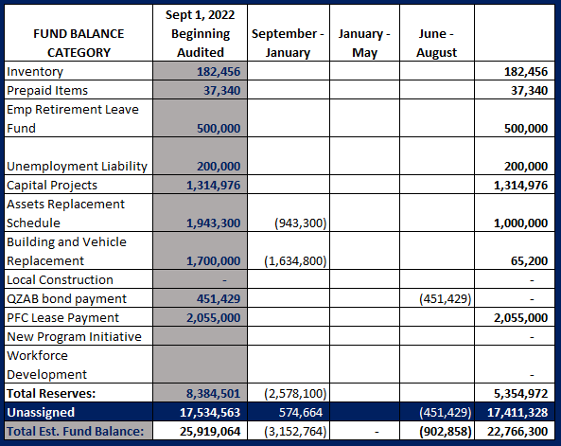
FY 2022-2023
Fund Balance
-
Budgeted Activity

Slide 12
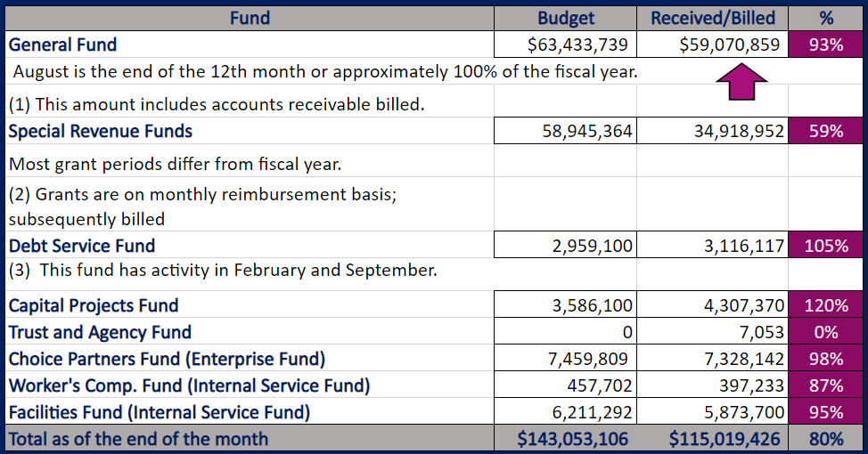
INTERIM FINANCIAL REPORT (unaudited)
GENERAL, SPECIAL REVENUE, DEBT SERVICE FUNDS, CAPITAL PROJECTS,
AND INTERNAL SERVICE FUNDS
REVENUES (INFLOWS)
Budget to Actual for period ending August 31, 2023

Slide 13
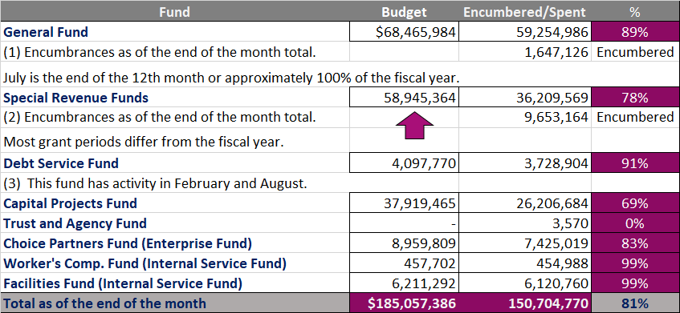
INTERIM FINANCIAL REPORT (unaudited)
GENERAL, SPECIAL REVENUE, DEBT SERVICE FUNDS, CAPITAL PROJECTS,
AND INTERNAL SERVICE FUNDS
Expenditures (OUTFLOWS)
Budget to Actual for period ending August 31, 2023

Slide 14
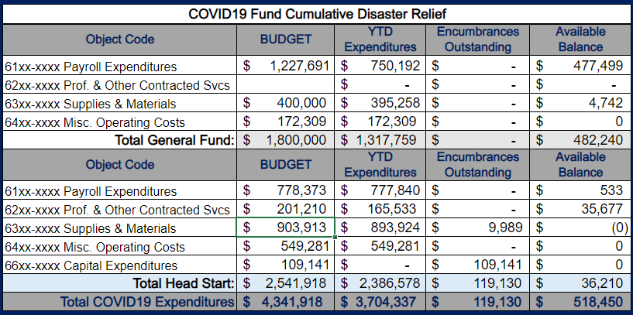
INTERIM FINANCIAL REPORT (unaudited) FY 2021 – 23 COVID19 Budget to Actual – Expenditures
for period ending August 31, 2023
All fund are already Committed
Head Start Grant Cycle ends by September 30th, 2023

Slide 15
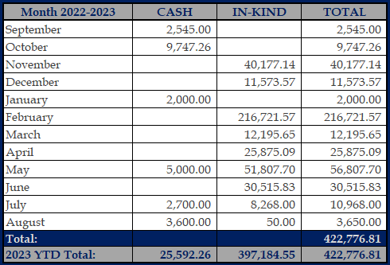
INTERIM FINANCIAL REPORT (unaudited)
FY 2022-23 Donations Report
All Funds as of August 31, 2023

Slide 16
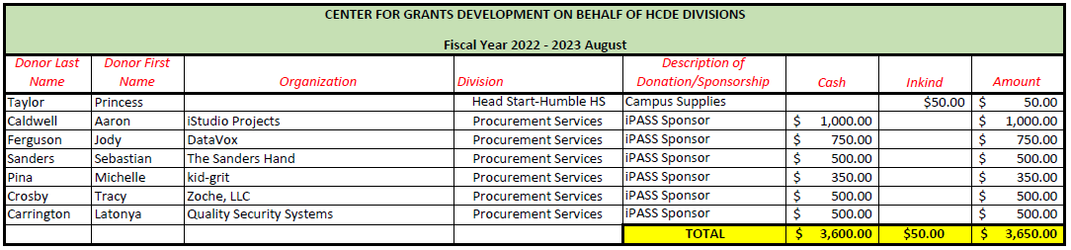
`
INTERIM FINANCIAL REPORT (unaudited)
FY 2022-23 Donations Report
All Funds as of August 31, 2023

Slide 17
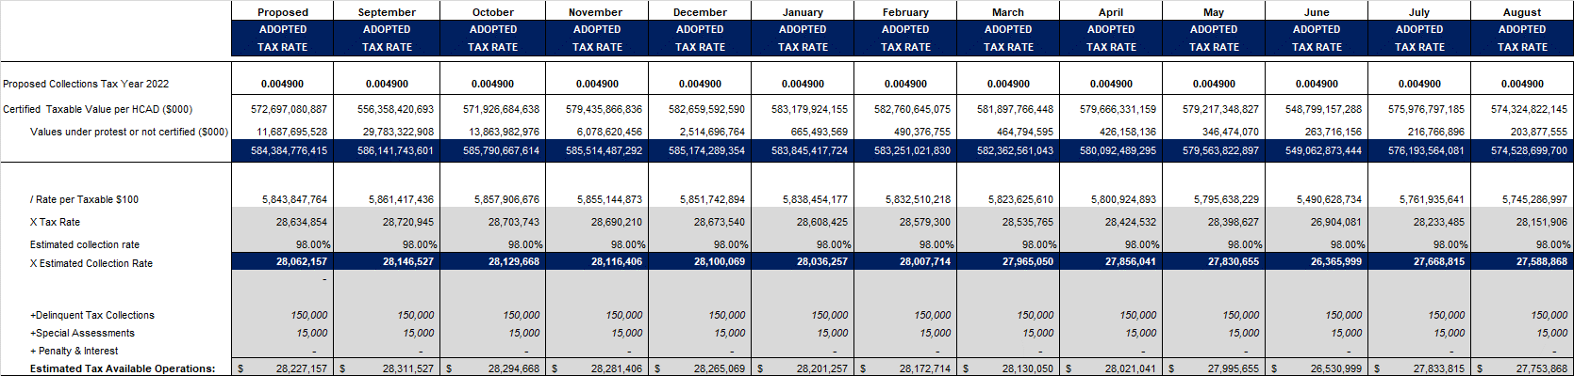
INTERIM FINANCIAL REPORT (unaudited)
TAX COLLECTIONS COMPARATIVE ANALYSIS
Fiscal Year-To-Date as of August 31, 2023
$574.5 B
See Tax Calculator at:
https://hcde-texas.org/transparency/tax-rate/
17

Slide 18
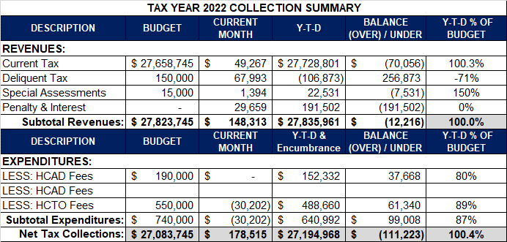
INTERIM FINANCIAL REPORT (unaudited) TAX COLLECTIONS
Fiscal Year-To-Date as of August 31, 2023
(12th month / 12 months)
a) 2022 Proposed Tax Rate = $0.004900/$100 Property Assessment/Appraisal - --> Annual Tax on a $259,375 - $75,219 = $201,066/100
x .004900 = $9.85 (net of 29% homestead exception.)
b) $740,000/$27,823,745 = 2.66% Collection and assessment costs

Slide 19
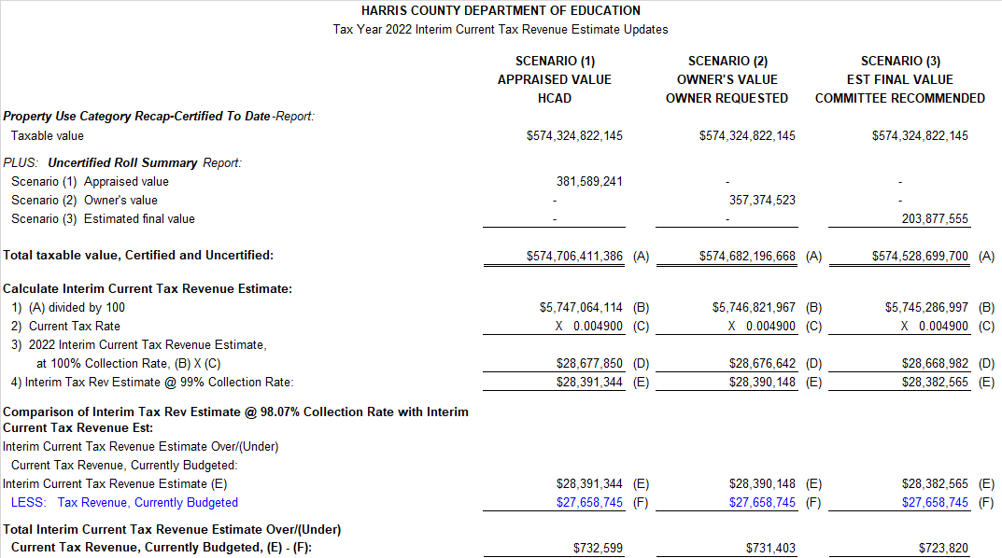
INTERIM FINANCIAL REPORT (unaudited) TAX COLLECTIONS
Fiscal Year-To-Date as of August 31, 2023
(12th month / 12 months)

Slide 20
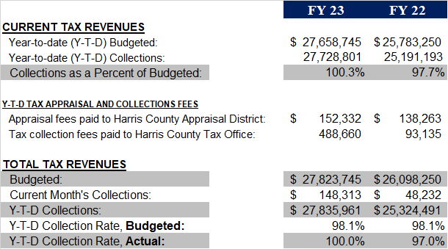
INTERIM FINANCIAL REPORT (unaudited) TAX COLLECTIONS
Fiscal Year-To-Date as of August 31, 2023
(12th month / 12 months)
2022 Adopted Tax Rate = $0.004900/$100 Property Assessment/Appraisal - --> Annual Tax on a $259,375 - $75,219 = $201,066/100 x .004900 = $9.85 (net of 29% homestead exception.)
b) $705,000/$25,188,000 = 2.80% Collection and assessment costs

Slide 21
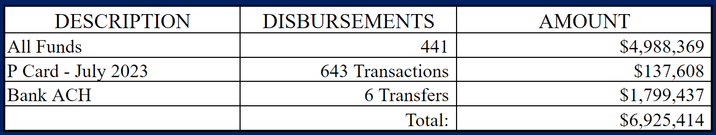
INTERIM FINANCIAL REPORT (unaudited)
DISBURSEMENT – ALL FUNDS
August 31, 2023
Notes:
All Purchase Orders and Payment Authorizations are reviewed before disbursement.
All Procurement Card charges are reviewed by cardholder, supervisor, and business office staff each month.
A report on CH Local Expenditures is included in the monthly report.

Slide 22
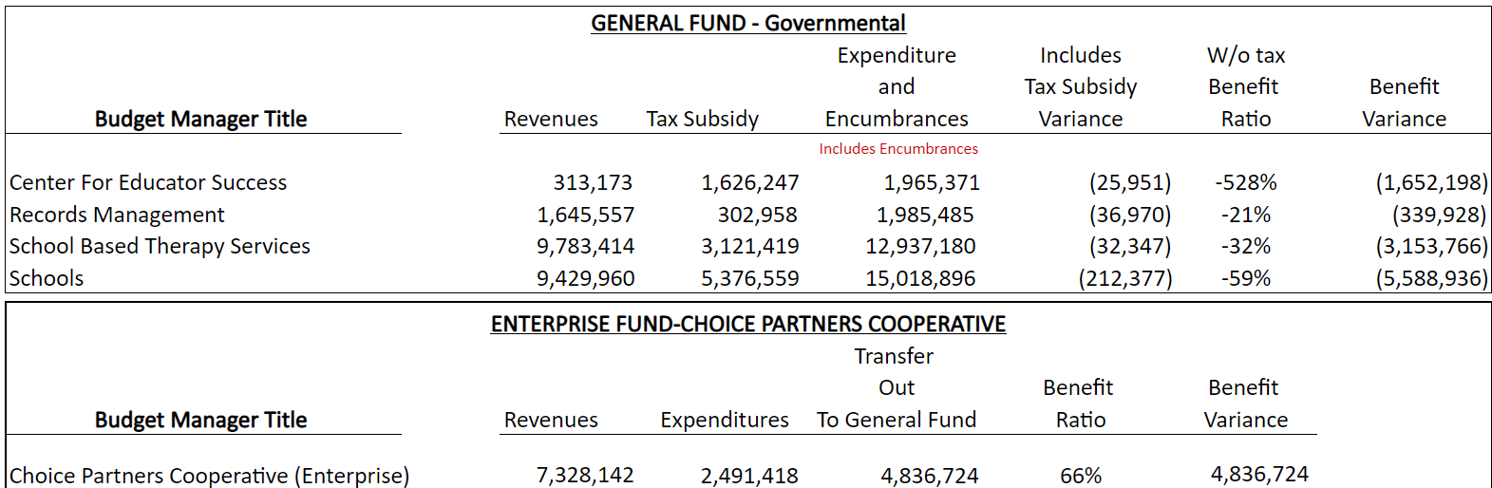
INTERIM FINANCIAL REPORT (unaudited)
Segment Division Data
As of August 31, 2023

Slide 23
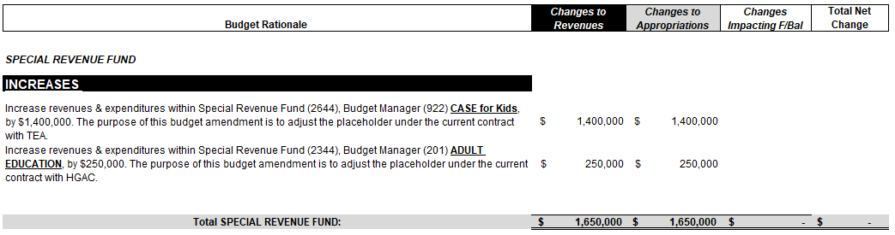
HIGHLIGHTS OF BUDGET AMENDMENT REPORT
September 20th Board Meeting
(unaudited)
Amendments
Special Revenue Fund Total: $ 1,650,000

Slide 24

Education Foundation Update
August 31, 2023

Slide 25
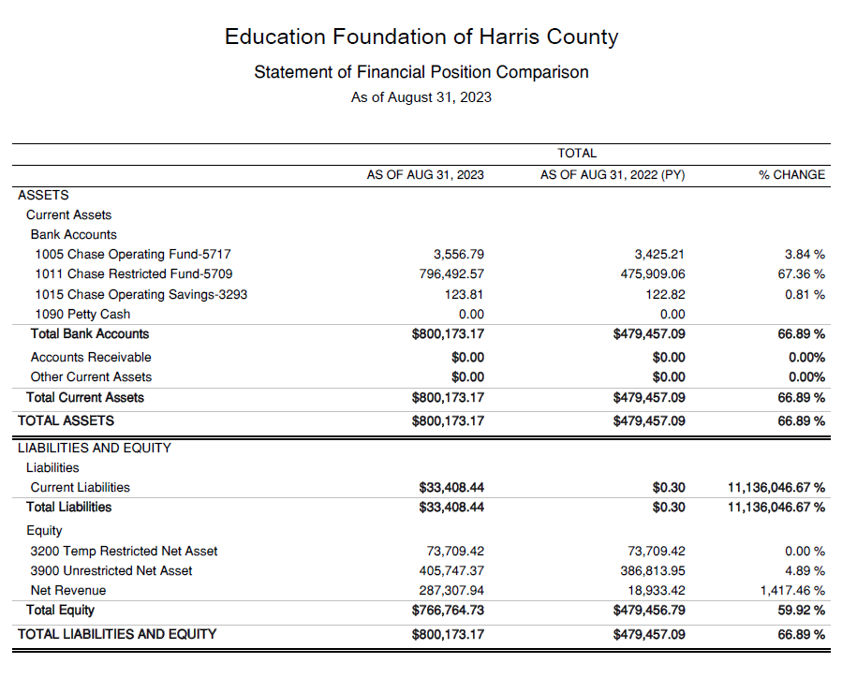
Statement of Financial Position
Net Equity $766,765

Slide 26
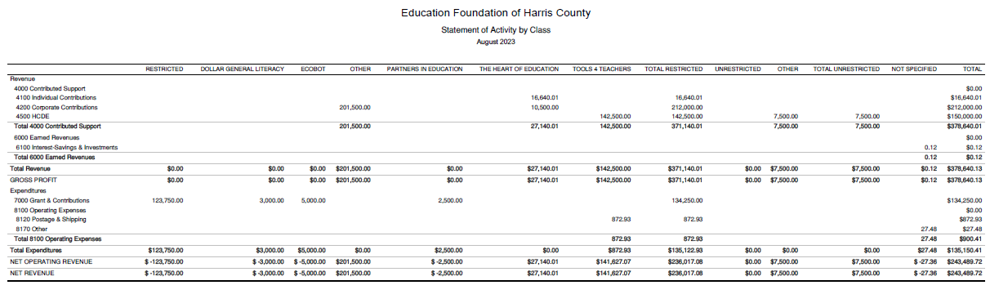
REVENUES
Statement of Activities Classified
$201,500
Houston Endowment
$27,140
The Heart of Education
$142,500
Tools For Teachers
$7,500
MOU
EXPENDITURES
$2,500
Sponsorship
$873
Tools For Teachers
$123,750
Houston Endowment

Slide 27
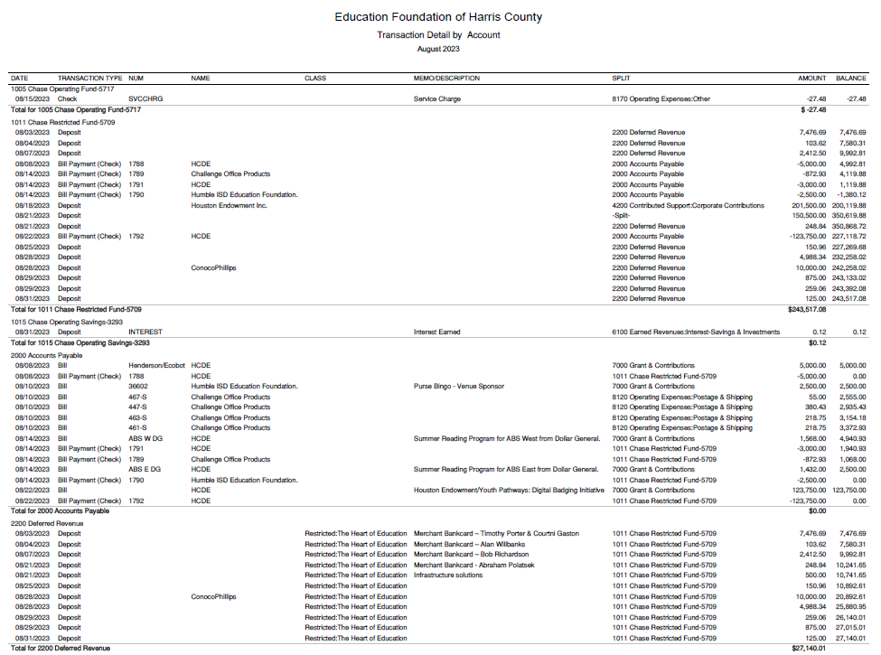
Transaction Detail by Inflow & Outflow

Slide 28
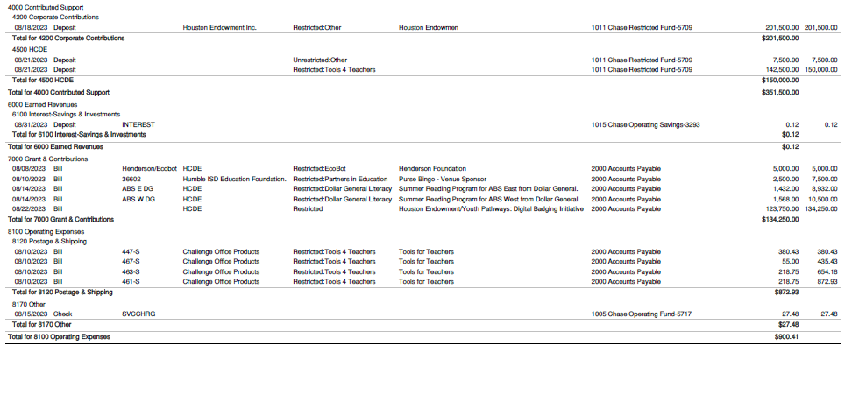
Transaction Detail by Inflow & Outflow

Slide 29
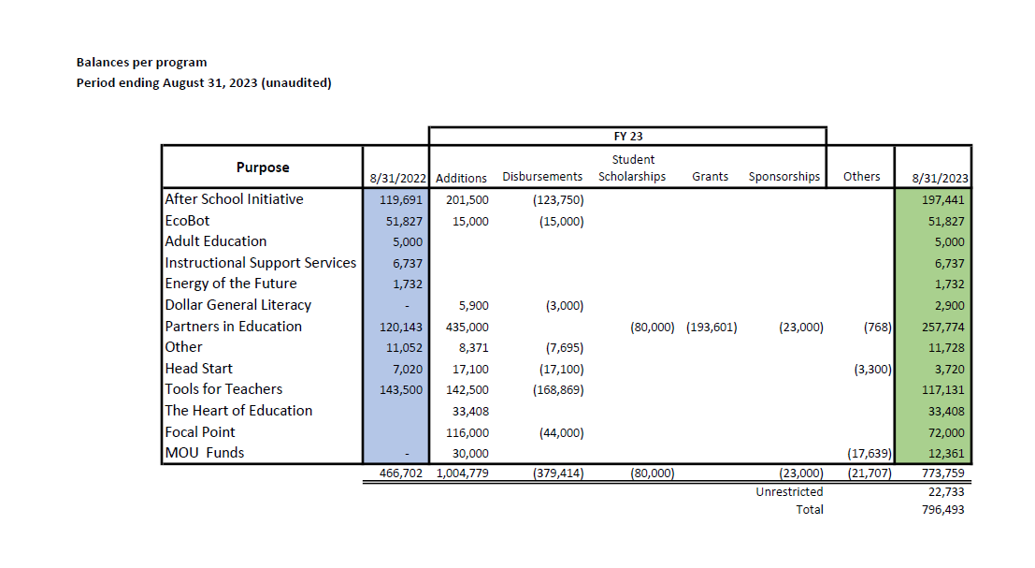
Balances Per Program

Slide 30

PFC & Lease Revenue Projects Update
August 31, 2023

Slide 31
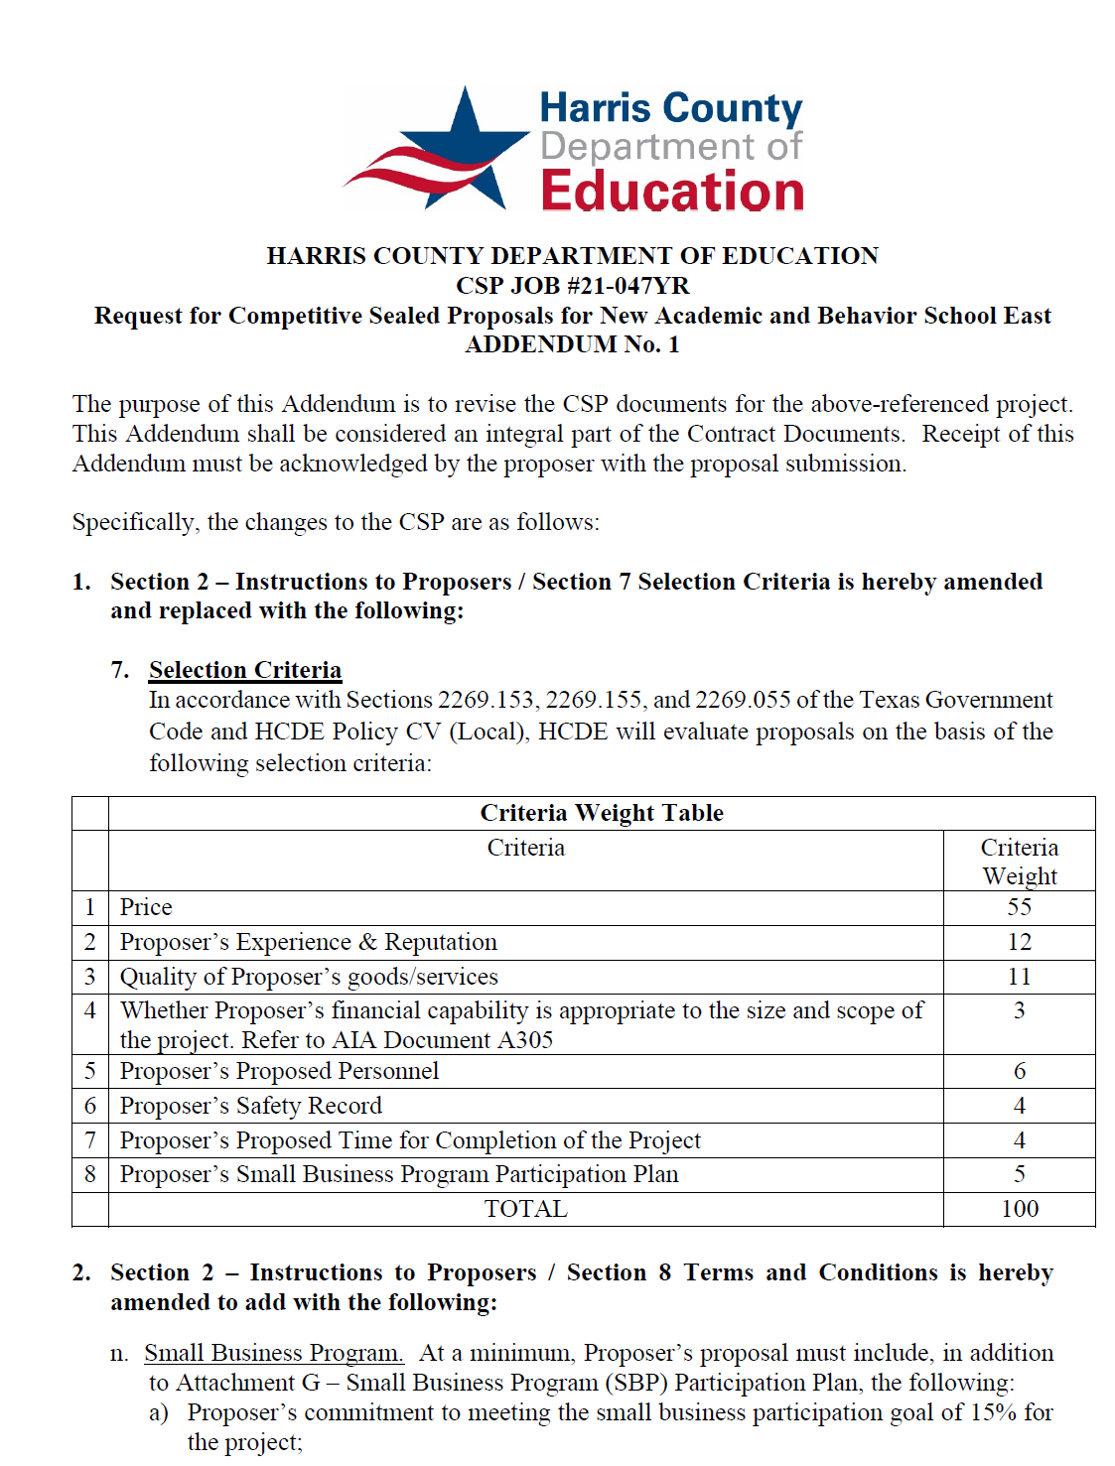
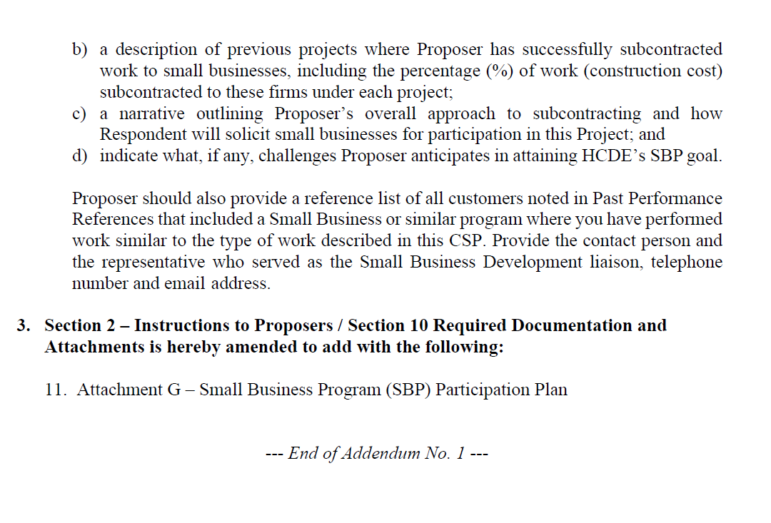
Small Business
Program for construction
Launch industry's first collaboration feature
This is our plan as we launch the industry's first collaboration feature

Slide 32
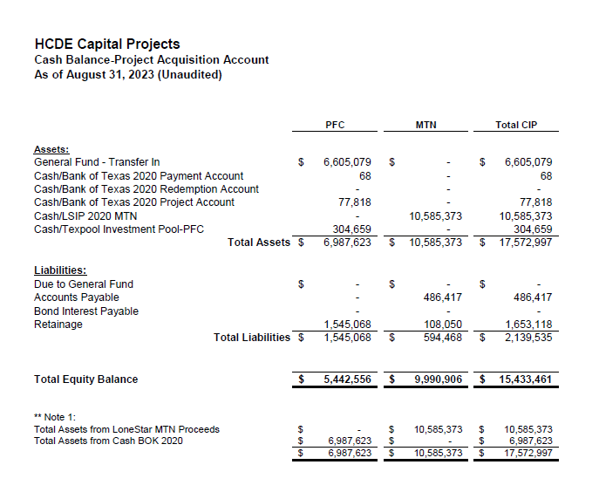

AB East School Contract $12,358,000 Awarded and Signed
Adult Ed Center Contract $15,121,000 awarded on Oct 2021 Board Mtg
HP East Contract $7,271,000 awarded on Nov 2021
Irvington – Pending Architect Assignment
Cash Balance –
Project Acquisition Account
As of August 31, 2023

Slide 33
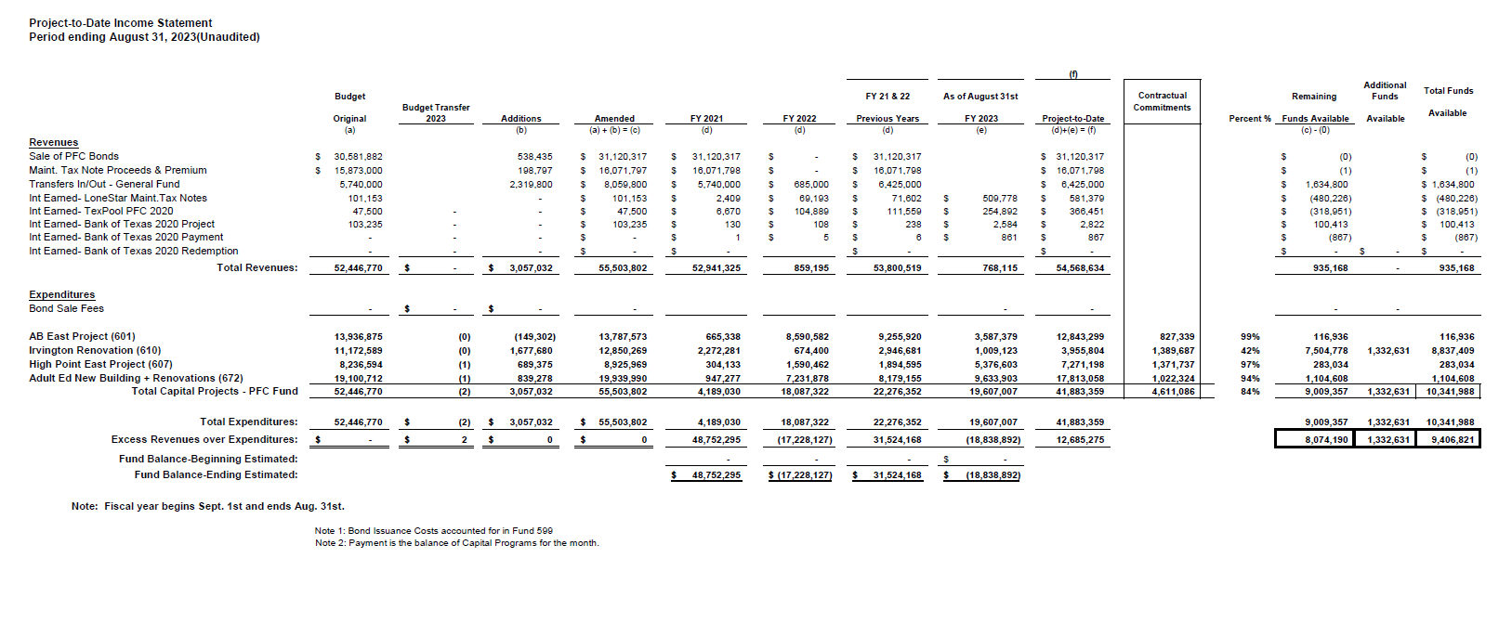
Income Statement– Project Acquisition Account
As of August 31, 2023

Slide 34
Irvington Renovation – Funds by Source
As of August 31, 2023
34

Slide 35

Capital Program Proposal from Aug 3, 2020
35

Slide 36






2020 Projected Capital Improvement Program
Project | Substantial Completion Date | Project Budget | Maintenance Notes Projected | Revenue Bonds Proceeds | General Funds Use of Fund Bal. | Interest Earnings Projection
Reagan Adm Bldg. | Feb 9, 2023 | $8,365,500 | $ 8,365,500 | N/A | N/A
Adult Ed Building | Oct 25, 2022 | $18,358,750 | $ 3,659,000 | $12,728,598 | $1,870,000 | $101,153
HP East Middle | Oct 25, 2022 | $7,916,645 | $ 1,089,500 | $4,909,645 | $1,870,000 | $47,500
Ab East Campus | Aug 16, 2022 | $17,805,875 | $ 2,759,000 | $12,943,640 | $2,000,000 | 103,235
 | Total | $52,446,770 | $15,873,000 | $30,581,882 | $5,740,000 | $251,888
 |  | Closed on 12-2-20 | Invested in pools.
Build a product accessible on all devices
This is our plan as we build a product accessible on all devices.
Note: The Total Public Notice was $54,000,000. ($35,000,000 for Revenue bonds and $19,000,000 for Maintenance Notes) on August 10, 2020. A transfer of $1,350,000 plus $50,000 in reimbursable expenditures was made from AB East to allocate Program Manager costs to establish the budgets.
Based on Pricing the principal amount will vary due to the premium projected in the bond sale. Revenues Bonds estimated at $27,730,000 and Maintenance Notes for $13,695,000

Slide 37

Interim Financial Report (Unaudited)
I certify that the foregoing information is true and accurate to the best of my knowledge.
/s/ Jesus J. Amezcua, RTSBA,CPA, Ph.D., CPFIM, Asst. Supt. for Business Support Services
/s/ Marcia Leiva, Chief Accounting Officer

